Slide 1
Lecture 8

Slide 2
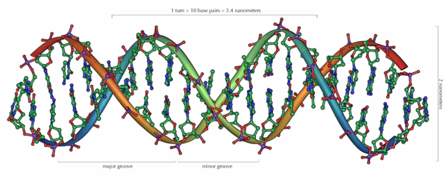
Methods in DNA Sequencing

Slide 3
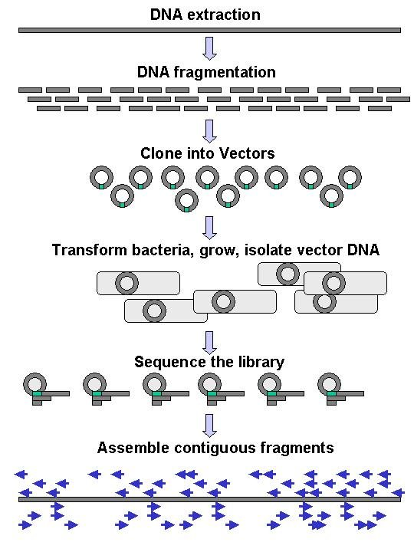
Big Picture
Large-scale sequencing requires DNA to be broken into fragments
Cutting (with enzymes)
Shearing (with mechanical forces)
DNA is duplicated into a vector
Individually sequenced
Assembled electronically
Shotgun sequencing

Slide 4
Brief Bio Background
Polymerase
DNA polymerase can add free nucleotides
No known DNA polymerase is able to begin a new chain
Ligase
Links together DNA fragments

Slide 5
First generation sequencing
Sanger Sequencing
Maxan Gilbert- chemical degradation method- toxic and radioactive chemicals
Three decades- Sanger sequencing dominated
Costly and time consuming

Slide 6
Second generation sequencing
Parallel sequencing
Cost
Time benefits
Sequencing output is read directly without the need for electrophoresis

Slide 7
1995 Whole genome sequencing [WGS] of Haemophilus influenzae
Craig Ventor’s group
1.8Mb genome on a circular chromosome
Reasons given in paper: a) genome size typical for bacteria b) G+C content (38%) similar to human genome c) physical map did not exist
Additional reason: Hamilton Smith (Nobel Prize Winner, Johns-Hopkins University) had worked on this bacterial strain for a long time. He discovered restriction enzymes working with H. influenzae. He is a senior author on the paper.

Slide 8
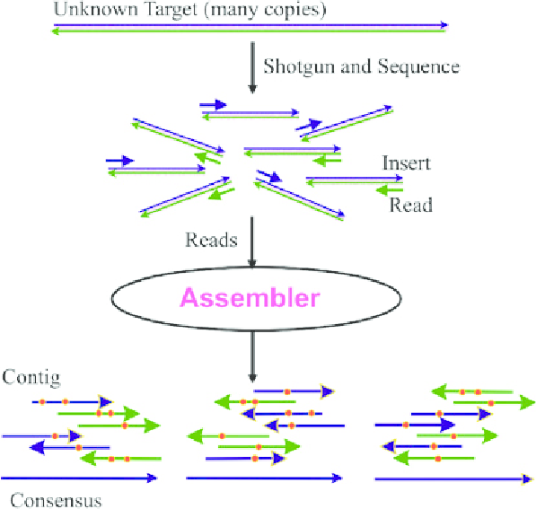
Shot-gun sequencing approaches

Slide 9
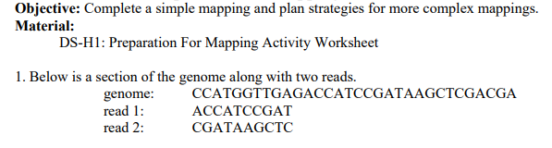
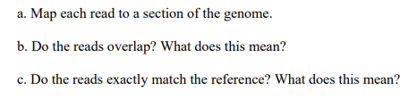
Activities and Worksheet

Slide 10
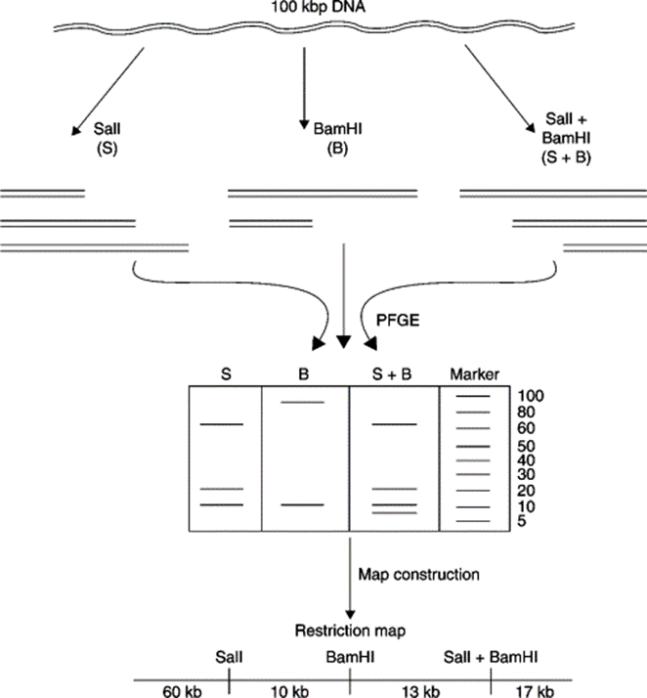
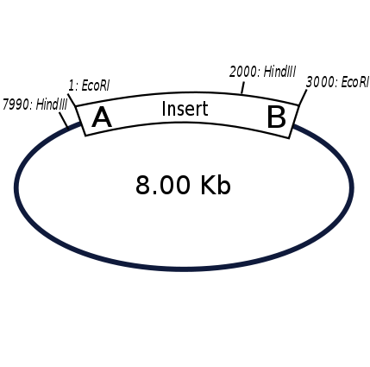
Aligning DNA sequences
Problems???

Slide 11
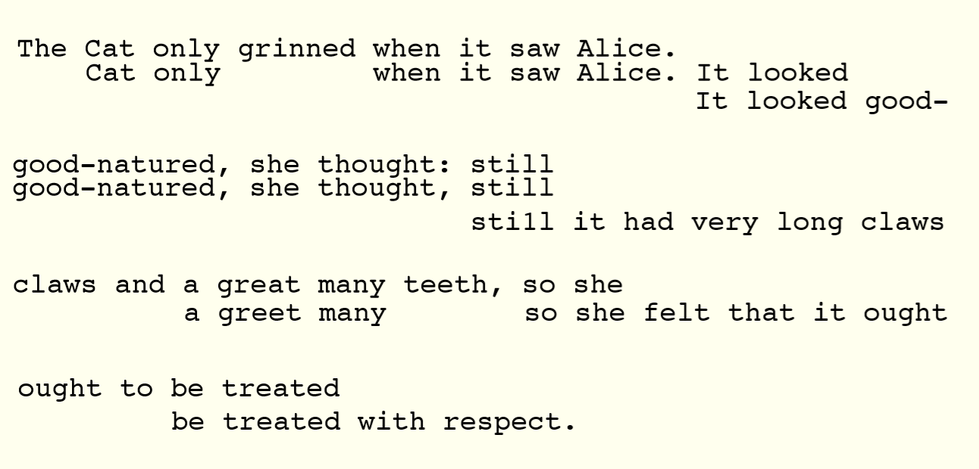

Slide 12
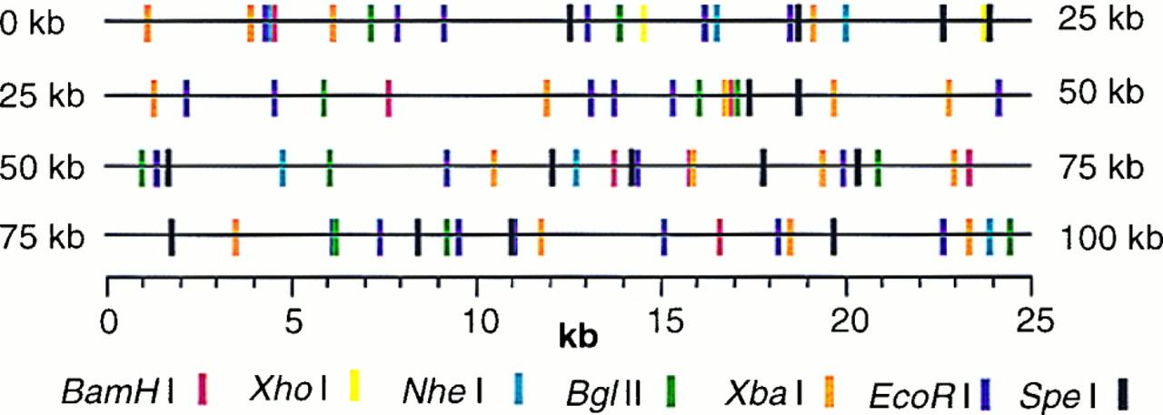
Restriction enzyme mapping
Missing contigs or gaps
Repetitive sequences

Slide 13
Analyzing DNA sequence
Searching for patterns
Comparing with existing sequences- Pairwise or multiple sequence alignment

Slide 14
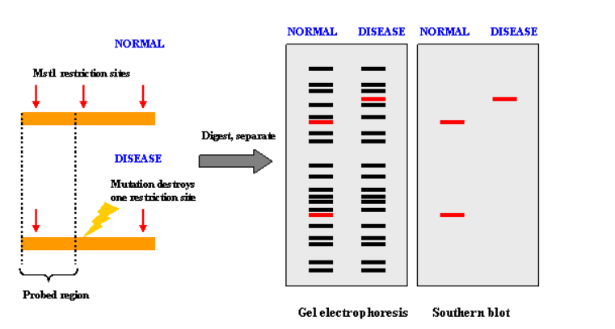
SNPsor INDELs can create or abolish restriction endonuclease (RE) recognition sites, thus affecting quantities and length of DNA fragments resulting from RE digestion.

Slide 15
Defining terminologies
Substitution
Insertion
Deletion
Frame shift

Slide 16
Annotation of DNA
DNA annotation is the process of identifying the locations of genes and coding regions in a genome to create ideas about the possible functions of the genes. There are three main steps to annotate the genome, which include to:
Identify the portions of the genome that are not involved in coding proteins
Identify the main elements of the genome (gene prediction)
Connect the main elements of the genome with biological information
It is important to consider how the genome is similar to other genomes that are already known, as this can help when establishing the role of the gene.

Slide 17
Definitions: identity, similarity, conservation
Homology
Similarity attributed to descent from a common ancestor.
Identity The extent to which two (nucleotide or amino acid) sequences are invariant.
Similarity
The extent to which nucleotide or protein sequences are related. It is based upon identity plus conservation.
Conservation
Changes at a specific position of an amino acid or (less commonly, DNA) sequence that preserve the physico-chemical properties of the original residue.

Slide 18
Greedy algorithm
Dynamic programming approach
Dot matrix
Scoring algorithms
Local and global alignment

Slide 19
Gene annotation- worksheet
http://gander.wustl.edu/cgi-bin/hgTracks?db=Dere2&lastVirtModeType=default&lastVirtModeExtraState=&virtModeType=default&virtMode=0&nonVirtPosition=&position=contig7%3A32469-32552&hgsid=233875_3xKFBctndOgkOO8zPyiiOwPWCQ1V

Slide 20
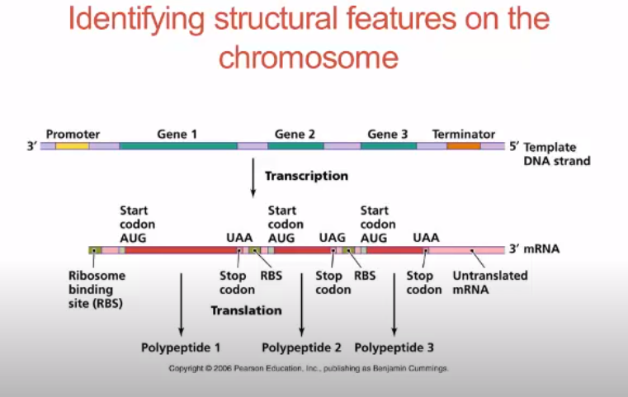
Genome annotation
https://www.youtube.com/watch?v=on4TMnuYTaU
https://www.youtube.com/watch?v=_N3XrrB2u9k

Slide 21
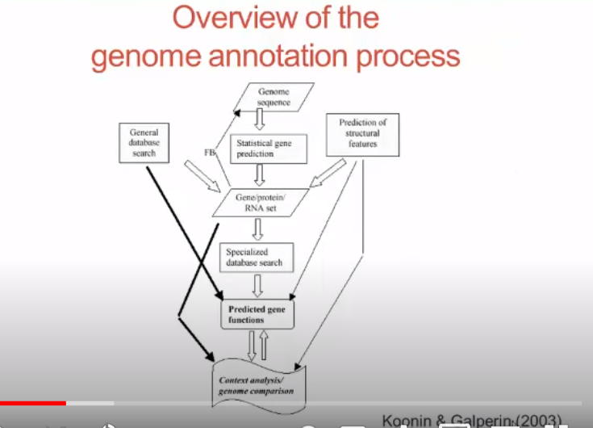

Slide 22
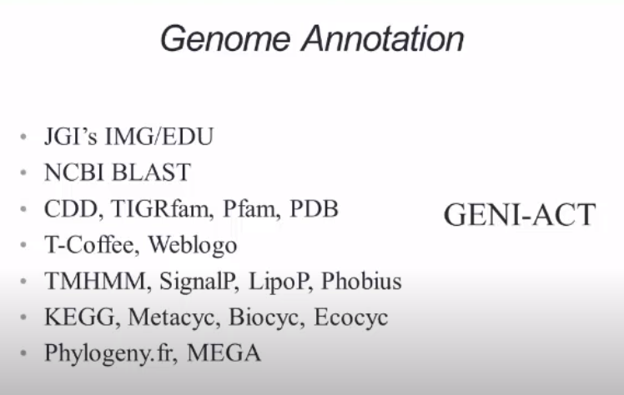

Slide 23
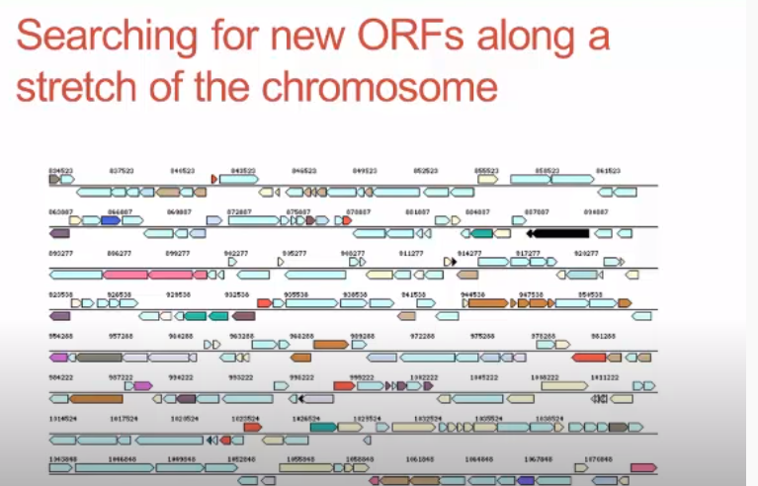

Slide 24
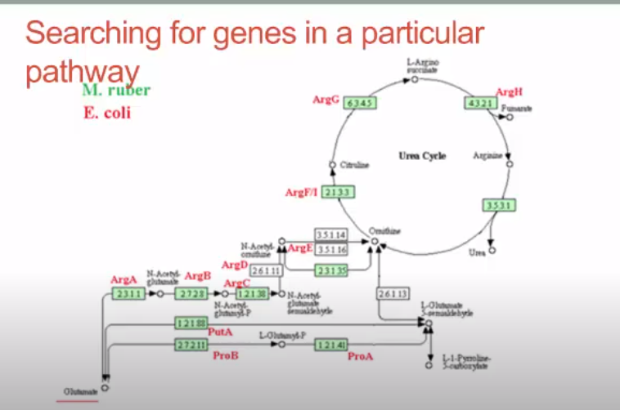

Slide 25
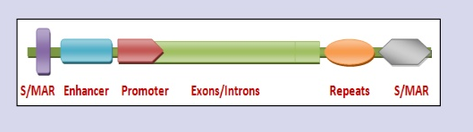
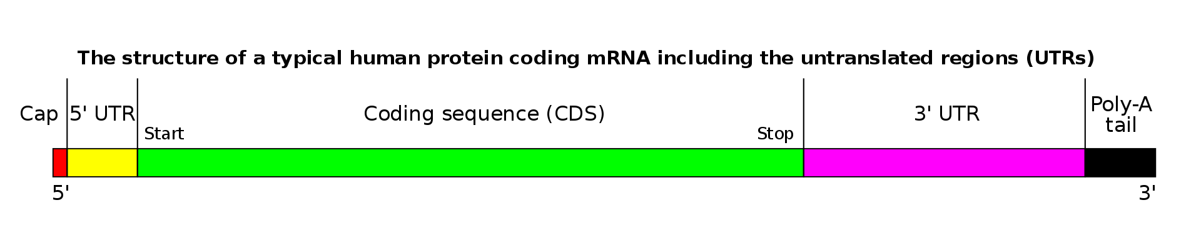
1. Signals
Localized motifs of various kinds
promoters
splice sites
start codons
stop codons
polyadenylation sites

